Slide 1
Relational Data Model

Slide 2
Entity Set
Entity: -Table
Attribute: -
Colour
Height
Weight
NumberOfLegs
MeterialUsed
Entity Set Table= {Colour, Height, Weight, NumberOfLegs, MaterialUsed}

Slide 3
Entity Set …
Entity: -Student
Attribute: -
Name
Height
Weight
Roll
Age [DOB] (cannot be considered here due to changing values. DOB will replace age)
Entity Set Student= {Name, Height, Weight, Roll, DOB, mobileNumber}

Slide 4
Entity Set …
struct student
{
int roll;
char name[25];
char doa[10]
struct student *prev;
struct student *next;
}s1,s2;
s1.next=&s2;

Slide 5
Entity Set …
S1
*prev
Roll
Name
DOA
&S2
S2
&s1
Roll
Name
DOA
*next

Slide 6
Types of Attribute
Simple
Roll
Height
Weight
Composite
Name
First Name
Last Name
Middle Name
Alias Name

Slide 7
Types of Attribute …
Derived
Age
Single Valued
Roll
Multi Valued
Mobile Number

Slide 8
Entity Diagram
Mobile Number
Roll
age
Mobile Number
Student
FirstName
MiddleName
Name
LastName
AliasName

Slide 9
Entity Relationship Diagram
Mobile Number
Mobile Number
TeacherId
age
Mobile Number
Roll
age
Mobile Number
n
Teaches
n
Teacher
Student
FirstName
FirstName
MiddleName
Name
Name
MiddleName
LastName
LastName
AliasName
AliasName

Slide 10
Entity Relationship Diagram
Mobile Number
Mobile Number
TeacherId
age
Mobile Number
Roll
age
Mobile Number
n
Teaches
n
Teacher
Student
FirstName
FirstName
MiddleName
Name
Name
MiddleName
LastName
LastName
AliasName
AliasName

Slide 11
Entity Relationship Model to Relational Model
EntityName will become RelationName i.e. TableName
EntityAttributes will become RelationAttributes i.e. TableAttributes
Table is also termed as Relation because, it denotes the logical relationship between/among attributes : Teacher, Student

Slide 12
Data Model
The structure of a database is termed as data model.
Collection of conceptual tools for
Describing Data
Data Relationships
Data Semantics
Consistency Constraints

Slide 13
Types of Data Model
Logical Data Model
Object Based Logical Model
Record Based Logical Model
Physical Data Model
Unifying Model
Frame Memory Model

Slide 14
Logical Model
The Model is used to describe the data at the Highest level.
Logical Data Model capture the logical i.e. relational aspects of the Database System Implementation.
The Logical Data Models are
Object Based Logical Model
Record Based Logical Model

Slide 15
Object Based Logical Model
The model is used in describing data at the logical and view levels.
Provide flexible structuring capabilities and allow data constraints to be specified explicitly.
The Object Based Logical Models are
Entity Relationship Model
Object Oriented Model
Semantic Data Model
Functional Data Model

Slide 16
Record Based Logical Model
The model is used in describing data at the logical and view levels.
As compared with the Object Based Data Model(s), the model is used to both specify the logical structure of the database and to provide the higher level description of the implementation.
The Model is termed as record based because the database is structured in fixed format records of different types.
The Record Based Logical Models are
Relational Data Model
Network Model
Hierarchical Model

Slide 17
Physical Model
The Model is used to describe the data at the lowest level.
Physical Data Model capture the aspects of the Database System Implementation.
The Physical Data Models are
Unifying Model
Frame Memory Model

Slide 18
Physical Model
The Model is used to describe the data at the lowest level.
Physical Data Model capture the aspects of the Database System Implementation.
The Physical Data Models are
Unifying Model
Frame Memory Model

Slide 19
Relational Model
Relational data model is the primary data model, which is used widely for data storage and processing.
This model is simple and it has all the properties and capabilities required to process data with storage efficiency.

Slide 20
Table
In relational data model, relations are saved in the format of Tables.
This format stores the relation among entities.
A table has rows and columns, where rows represents records and columns represent the attributes.

Slide 21
Tuple
A single row of a table, which contains a single record for that relation is called a tuple.

Slide 22
Relational Instance
A finite set of tuples in the relational database system represents relation instance.
Relation instances do not have duplicate tuples.

Slide 23
Relational Schema
A relational schema describes the relation name (table name), attributes, and their names.

Slide 24
Relational Key
Each row has one or more attributes, known as relation key, which can identify the row in the relation (table) uniquely.

Slide 25
Relational Key
Each row has one or more attributes, known as relation key, which can identify the row in the relation (table) uniquely.

Slide 26
Types of Relational Key
Primary Key
Candidate key
Alternate Key
Foreign Key
Super Key

Slide 27
Super Key
A set of attributes that collectively identifies an entity in an entity set.

Slide 28
Primary Key
A primary key a set of one or more attributes that can uniquely identify tuples within the relation.

Slide 29
Candidate Key
All the attribute combinations inside a relation that can serve as primary key are termed as candidate keys because they are the candidates for the primary key position.

Slide 30
Alternate Key
A candidate key that is not the primary key is termed as Alternate Key.

Slide 31
Foreign Key
Non Key Attribute, whose values are derived from the primary key of some other table is known as foreign key in its current table.

Slide 32
Attribute Domain
Every attribute has some pre-defined value scope, known as attribute domain.

Slide 33
Types of Constraints
There are three main integrity constraints −
Key constraints
Domain constraints
Referential integrity constraints

Slide 34
Key Constraints
There must be at least one minimal subset of attributes in the relation, which can identify a tuple uniquely.
This minimal subset of attributes is called key for that relation.
If there are more than one such minimal subsets, these are called candidate keys.
Key constraints force that in a relation with a key attribute, no two tuples can have identical values for key attributes.
A key attribute can not have NULL values.
Key constraints are also referred to as Entity Constraints.

Slide 35
Referential Integrity Constraints
Referential integrity constraints work on the concept of Foreign Keys.
A foreign key is a key attribute of a relation that can be referred in other relation.
Referential integrity constraint states that if a relation refers to a key attribute of a different or same relation, then that key element must exist.

Slide 36
Query Language
Relational database systems are expected to be equipped with a query language that can assist its users to query the database instances.

Slide 37
Types of Query Language
There are two kinds of query languages
Relational Algebra
Relational Calculus

Slide 38
Relational Algebra
Relational algebra is a “procedural query language”, which takes instances of relations as input and yields instances of relations as output.
It uses “operators” to perform queries.
An operator can be either unary or binary.
They accept “relations” as their input and yield “relations” as their output.
Relational algebra is performed recursively on a relation and intermediate results are also considered relations.

Slide 39
Basic Operations in Relational Algebra
Selection Operation
Projection Operation
Union Operation
Set Different Operation (-)
Intersection Operation
Cartesian Product
Rename

Slide 40
Selection Operation i.e. “select” i.e. ‘σ’
It selects tuples that satisfy the given predicate from a relation. “select * from student;”
The general syntax of “selection operation” i.e. “select” i.e. ‘σ’ is “σp(r)”, where
σ stands for selection predicate
r stands for relation
p is propositional logic formula which may use connectors like and, or, and not.
These terms may use relational operators like =, ≠, ≥, < , >, ≤.

Slide 41
Selection Operation i.e. “select” i.e. ‘σ’ …
Let us consider the selection operation “σ subject = “database”(Books)”. σ p(r)→ σ name != “Anirban”(student)” → select * from student where name != “Anirban”;
The above selection operation “Selects tuples from books where subject is “database”.”.
Let us consider the selection operation “σ subject = "database" and i.e. & price = "450"(Books)”, “select * from books where subject = “database” and price=450;”
The above selection operation “Selects tuples from books where subject is “database” and “price” is 450.”.

Slide 42
Selection Operation i.e. “select” i.e. ‘σ’ …
Let us consider the selection operation “σsubject = "database" and price = "450" or year > "2010"(Books) i.e. “select *from books where subject = “database” and price=450 or year>2010;”
The above selection operation “Selects tuples from books where subject is “database” and “price” is 450 or 450 or those books published after 2010.”.

Slide 43
Projection Operation i.e. “Project” i.e. ‘∏’
The projection operation i.e.∏ projects column(s) that satisfy a given predicate. “select * from student where classRoll>710;”
The general syntax is ∏A₁, A₂, … ,A_{n} (r), where A₁, A₂, … ,A_{n} are attribute names of relation r. “∏ i.e. project _{classRoll>710} * (student);”
Duplicate rows are automatically eliminated, as relation is a set.
Let us consider the following projection operation “∏subject, author (Books)”. “select subject, author from books;”

Slide 44
Query Execution
Query Execution
Query has to be designed
Query is to be executed
read the corresponding values i.e. selection operation
Write the corresponding values to the output device i.e. projection operation

Slide 45
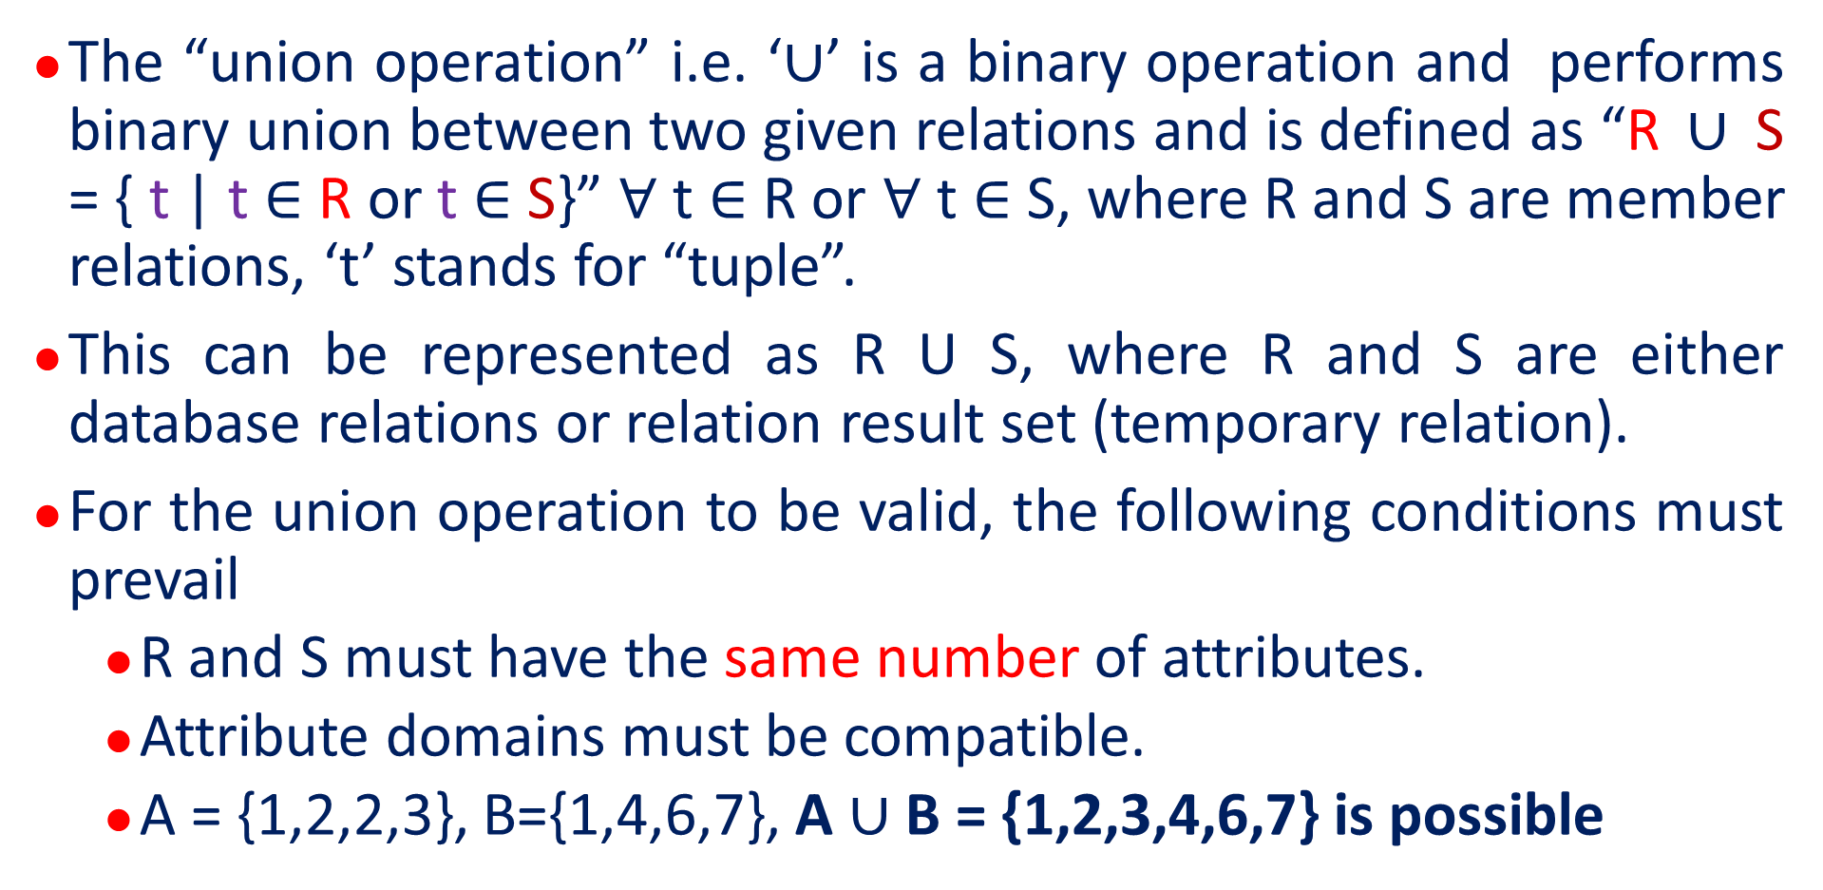
Union Operation i.e. ∪ …
The “union operation” i.e. ‘∪’ is a binary operation and performs binary union between two given relations and is defined as “R ∪ S = { t | t ∈ R or t ∈ S}” $∀$ t $∈$ R or $∀$ t $∈$ S, where R and S are member relations, ‘t’ stands for “tuple”.
This can be represented as R U S, where R and S are either database relations or relation result set (temporary relation).
For the union operation to be valid, the following conditions must prevail
R and S must have the same number of attributes.
Attribute domains must be compatible.
A = {1,2,2,3}, B={1,4,6,7}, A ∪ B = {1,2,3,4,6,7} is possible

Slide 46
Union Operation i.e. ∪ …
Duplicate tuples are automatically eliminated.
Considering the union operation “∏ author (Books) ∪ ∏ author (Articles)”. n(A ∪ B) = n(A) + n(B)-n(A intersection B)
The above union operation “Projects the names of the authors who have either written a book or an article or both.”.

Slide 47
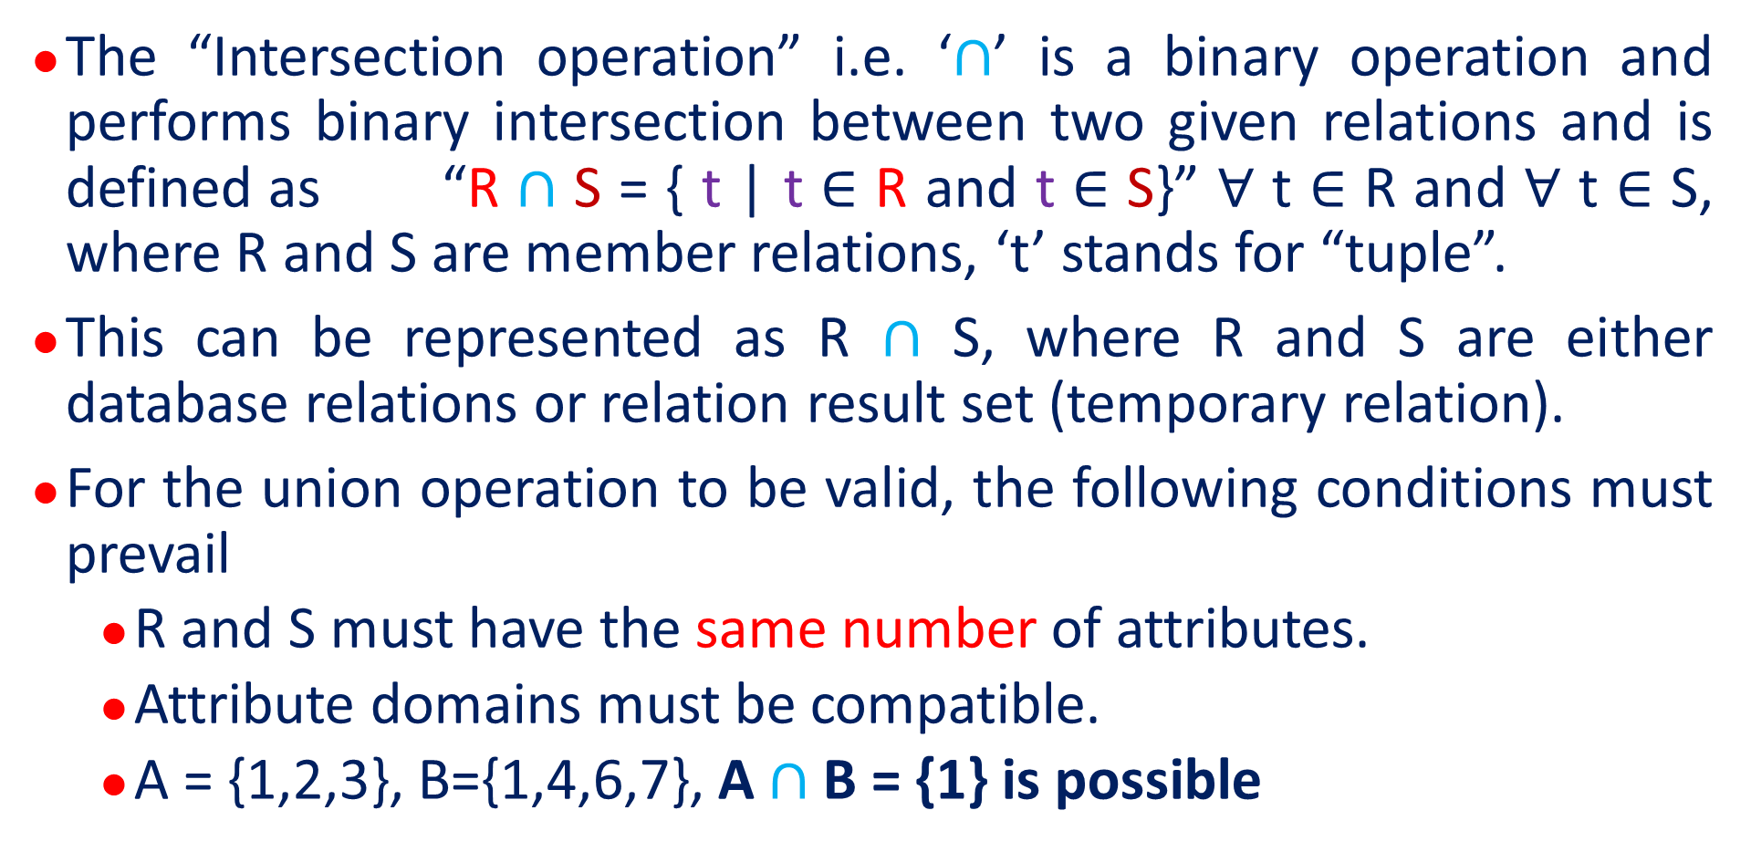
Intersection Operation i.e. ∩
The “Intersection operation” i.e. ‘$∩$’ is a binary operation and performs binary intersection between two given relations and is defined as “R $∩$ S = { t | t ∈ R and t ∈ S}” $∀$ t $∈$ R and $∀$ t $∈$ S, where R and S are member relations, ‘t’ stands for “tuple”.
This can be represented as R $∩$ S, where R and S are either database relations or relation result set (temporary relation).
For the union operation to be valid, the following conditions must prevail
R and S must have the same number of attributes.
Attribute domains must be compatible.
A = {1,2,3}, B={1,4,6,7}, A $∩$ B = {1} is possible

Slide 48

Intersection Operation i.e. ∩ …
Duplicate tuples are automatically eliminated.
Considering the intersection operation “∏ author (Books) $∩$ ∏ author (Articles)”.
The above union operation “Projects the names of the authors who have written both a book and an article”.

Slide 49
Set Difference Operation i.e. −
The set difference operation is binary in nature i.e. requires two operands to operate upon. A, B: A-B= A – (A Intersection B)
The required operands are nothing but the relations.
The result of set difference operation is tuples, which are present in one relation but are not in the second relation.
The general syntax is “R − S”, which results in all the tuples that are present in R but not in S.
Considering the set difference operation “∏ author (Books) − ∏ author (Articles)”.

Slide 50
Set Difference Operation i.e. − …
The above set difference operation results in “the name of authors who have written books but not articles” i.e. “the name of authors who have authored books only”.

Slide 51
Cartesian Product i. e. ‘Χ’
The cartesian product operation is used to combine information of two different relations into one.
The general syntax is “R Χ S”, where ‘R’ and ‘S’ are relations and their output s defined in the form of “R Χ S = { (rs) | r ∈ R and s ∈ S}”.
Let A={1, 2, 3} and B={a, b, c} then AXB = {(1,a),(1,b),(1,c),(2,a),(2,b),(2,c),(3,a),(3,b),(3,c)}.
Considering the cartesian product operation “∏_{author = “XYZ”} (Books Χ Articles)”

Slide 52
Cartesian Product i. e. ‘Χ’ …
The above cartesian product operation produces the a temporary relation “Books X Articles”, which shows all the books and articles authored by the author = “XYZ”.

Slide 53
Rename Operation i.e. ρ
The rename operation is used to rename the output relation.
The results of relational algebra are also relations but they are without any name.
The rename operation is denoted with small Greek letter rho(ρ).
The general syntax ρ x (E), where the result of expression E is saved with name of x.

Slide 54
Join
“Join” in “DBMS” is a binary operation that allows us to combine join product and selection in one single statement.
The main goal behind creating a join condition is that it helps us to combine the data from two or more DBMS tables.
The tables in DBMS are associated using the primary key and foreign keys.

Slide 55
Types of Join
Inner Join
Theta Join
Natural Join
Equi Join
Outer Join
Left Join
Right Join
Full Join

Slide 56
Inner Join
“Inner Join” is used to return rows from both tables which satisfy the given condition.
It is the most commonly used join operation and can be considered as a default join-type
An Inner join is a comparator based join. When it uses “equality comparisons” in the “join predicate”, it becomes “equijoin”.
In case of use of other comparison operators like “>”, We cannot term it as equijoin.

Slide 57
Inner Join …
Considering the relations Subject(SubID, SubName, Teachno) and Teacher(TeachID, TeachName)
“select Subject.SubID, Subject.Teachno from Subject INNER JOIN Teacher ON Subject.Teachno=Teacher.TeachID;”. As ‘=’ operator is used “Inner Join is implemented in the form of Equi Join”
“select Subject.SubID, Subject.Teachno from Subject INNER JOIN Teacher ON Subject.Teachno!=Teacher.TeachID;”. As ‘!=’ operator is used “Inner Join is implemented in the form of Theta join”

Slide 58
Primary Key and Foreign Key
Considering the relations Subject(SubID, SubName, TeachID) and Teacher(TeachID, TeachName)
“create table Teacher(TeachID varchar2(10) primary key, TeachName varchar2(25));
“create table subject(SubID varchar2(10) primary key, SubName varchar2(25), TeachID varchar2(10) references Teacher(TeachID));

Slide 59
Inner Join …
Considering the relations Subject(SubID, SubName, TeachID) and Teacher(TeachID, TeachName)
“select Subject.SubID, Subject.TeachID from Subject INNER JOIN Teacher ON Subject.TeachID=Teacher.TeachID;”. As ‘=’ operator is used “Inner Join is implemented in the form of Natural Join because the attribute “TeachID” is common to both member operands i.e. “Subject” and “Teacher”.”

Slide 60
Inner Join …
“select Subject.SubID, Subject.TeachID from Subject INNER JOIN Teacher ON Subject.TeachID!=Teacher.TeachID;”. As ‘!=’ operator is used “Inner Join is implemented in the form of Natural Join because the attribute “TeachID” is common to both member operands i.e. “Subject” and “Teacher”.”

Slide 61
Types of Inner Join
“Inner Join” is of three types
Theta Join
Natural Join
Equi Join

Slide 62
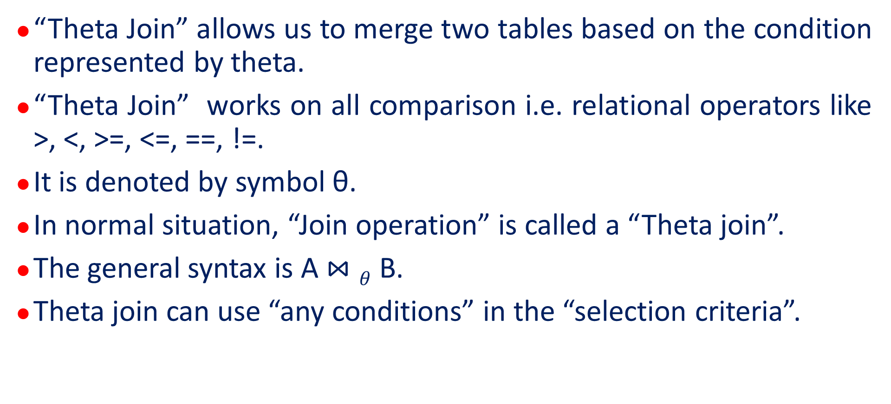
Theta Join
“Theta Join” allows us to merge two tables based on the condition represented by theta.
“Theta Join” works on all comparison i.e. relational operators like >, <, >=, <=, ==, !=.
It is denoted by symbol θ.
In normal situation, “Join operation” is called a “Theta join”.
The general syntax is A $⋈θ$ B.
Theta join can use “any conditions” in the “selection criteria”.

Slide 63
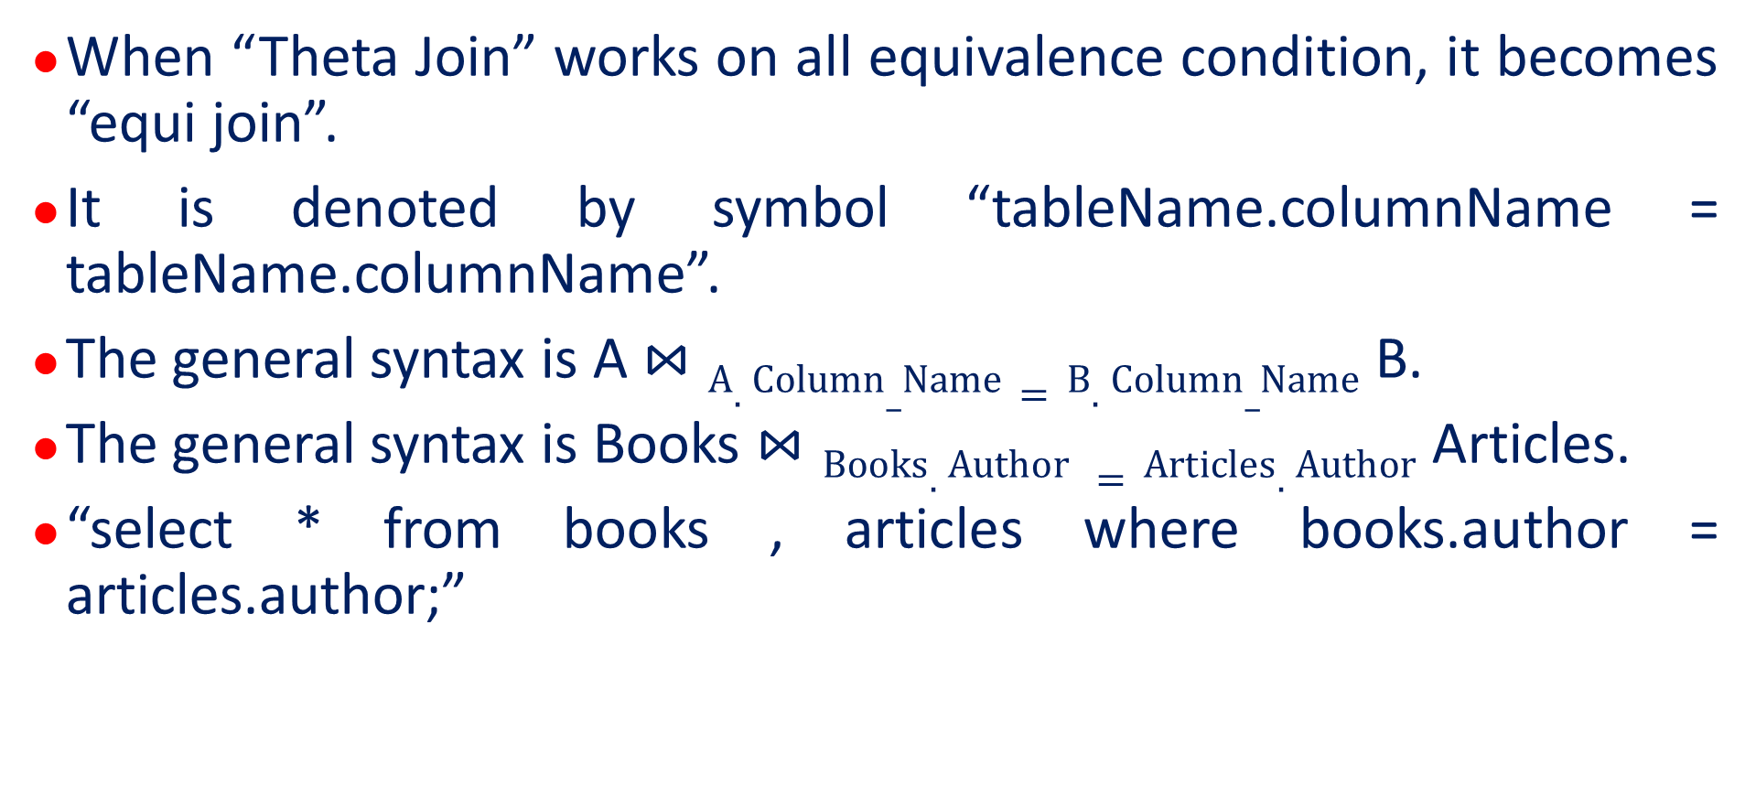
Equi Join
When “Theta Join” works on all equivalence condition, it becomes “equi join”.
It is denoted by symbol “tableName.columnName = tableName.columnName”.
The general syntax is A $⋈A.Column_Name=B.Column_Name$ B.
The general syntax is Books $⋈Books.Author =Articles.Author$ Articles.
“select * from books , articles where books.author = articles.author;”

Slide 64
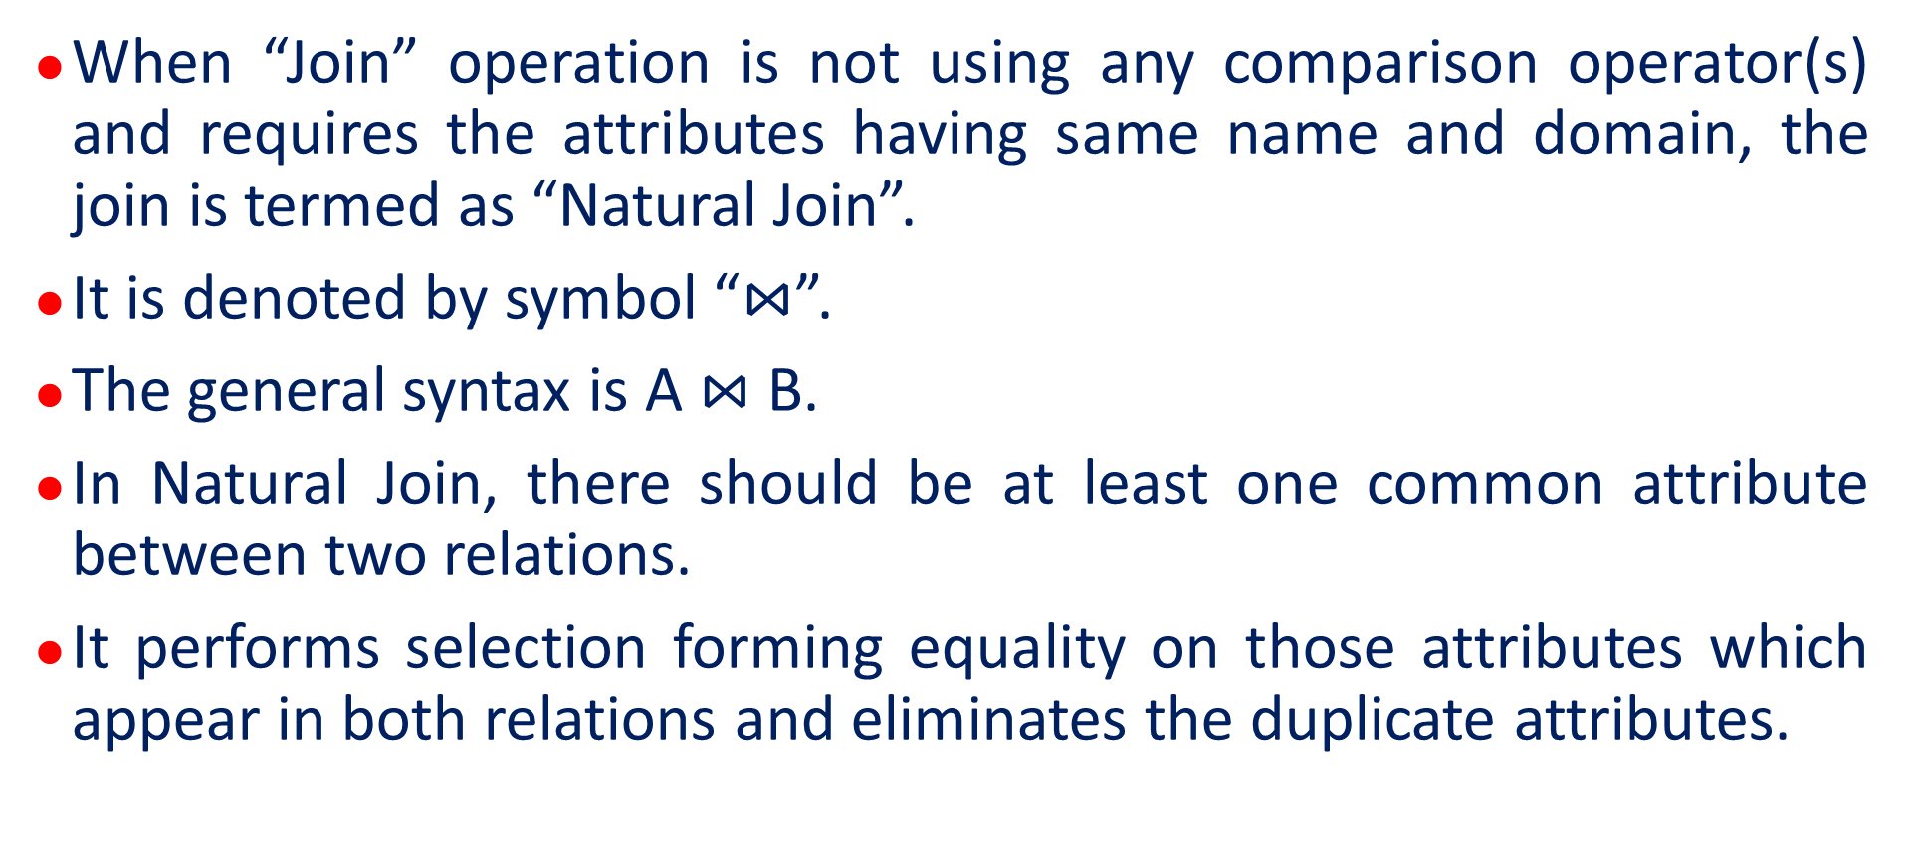
Natural Join
When “Join” operation is not using any comparison operator(s) and requires the attributes having same name and domain, the join is termed as “Natural Join”.
It is denoted by symbol “$⋈$”.
The general syntax is A $⋈$ B.
In Natural Join, there should be at least one common attribute between two relations.
It performs selection forming equality on those attributes which appear in both relations and eliminates the duplicate attributes.

Slide 65
Outer Join
“Outer Join” doesn't require each record in the two join tables to have a matching record.
In case of no matching record(s), the table retains each record.
Outer Join is of three types. They are
Left Outer Join
Right Outer Join
Full Outer Join

Slide 66
Left Outer Join
“Left Join” returns all the rows from the table on the left even if no matching rows have been found in the table on the right.
When no matching record found in the table on the right, “NULL” is returned.
Let A and B are two tables so that the “left outer join” on A and B is given by A B.

Slide 67
Left Outer Join …
The syntax of left outer join is “SELECT columnName(s) FROM table1 LEFT JOIN table2 ON table1.columnName = table2.columnName;”
Considering the relations Subject(SubID, SubName, TeachID) and Teacher(TeachID, TeachName)
“select Subject.SubID, Subject.TeachID from Subject LEFT JOIN Teacher ON Subject.TeachID=Teacher.TeachID;”.

Slide 68
Right Outer Join
“Right Join” returns all the rows from the table on the right even if no matching rows have been found in the table on the left.
When no matching record found in the table on the left, “NULL” is returned.
Let A and B are two tables so that the “right outer join” on A and B is given by A B.

Slide 69
Right Outer Join …
The syntax of right outer join is “select columnName(s) FROM table1 right join table2 ON table1.columnName = table2.columnName;”
Considering the relations, Orders(OrderID, EmployeeID) and Employees(EmloyeeID, FrstName, LastName).
select Orders.OrderID, Employees.LastName, Employees.FirstName FROM Orders RIGHT JOIN Employees ON Orders.EmployeeID = Employees.EmployeeID;

Slide 70
Right Outer Join …
The syntax of right outer join is “select columnName(s) FROM table1 right join table2 ON table1.columnName = table2.columnName;”
SELECT Orders.OrderID, Employees.LastName, Employees.FirstName FROM Orders RIGHT JOIN Employees ON Orders.EmployeeID = Employees.EmployeeID ORDER BY Orders.OrderID;

Slide 71
Right Outer Join …
“Right Join” returns all the rows from the table on the right even if no matching rows have been found in the table on the left.
When no matching record found in the table on the left, “NULL” is returned.
Let A and B are two tables so that the “right outer join” on A and B is given by A B.

Slide 72
Full Outer Join
Irrespective of the matching condition, “Full Outer Join” returns all the records (rows or tuples) from both relations that are included in the result.
Let A and B are two tables so that the “right outer join” on A and B is given by A B.

Slide 73
Full Outer Join …
The Syntax of Full Outer Join is “select column_name(s) FROM table1 full outer join table2 ON table1.column_name = table2.column_name where condition;”.
SELECT Customers.CustomerName, Orders.OrderID FROM Customers FULL OUTER JOIN Orders ON Customers.CustomerID=Orders.CustomerID ORDER BY Customers.CustomerName;

Slide 74
Relational Calculus
Relational Calculus is a non-procedural query language.
It tells what to do but never explains how to do it.
In place of algebra, relational calculus uses mathematical predicate calculus.
The relational calculus is entirely different as compare to differential calculus and integral calculus in mathematics
Relational Calculus takes its name from the branch of symbolic logic termed as predicate calculus.

Slide 75
Types of Relational Calculus
Relational calculus exists in two forms
Tuple Relational Calculus
Domain Relational Calculus

Slide 76
Types of Relational Calculus
Relational calculus exists in two forms
Tuple Relational Calculus
Domain Relational Calculus

Slide 77
Entity Relational Model to Relational Model
Entity Relation Model, when conceptualized into diagrams, gives a good overview of entity-relationship, which is easier to understand.
Entity Relation Diagrams can be mapped to Relational Schema i.e. it is possible to create Relational Schema using Entity Relation Diagram.
We cannot import all the Entity Relation constraints into relational model, but an approximate schema can be generated.
There are several processes and algorithms available to convert ER Diagrams into Relational Schema.

Slide 78
Entity Relational Model to Relational Model …
Some of them are automated and some of them are manual.
We will focus on mapping the entity relation diagram contents to relational basics.

Slide 79
Entity Diagram includes …
Entity and its attributes
Relationship, which is association among entities

Slide 80
Mapping Entity
An entity is nothing but a real world object.
An entity is characterized by its properties termed as characteristics or attributes.

Slide 81
Mapping Process for Entity i.e. Algorithm
Create table for each entity.
Entity's attributes should become fields of tables with their respective data types.
Declare primary key.

Slide 82
Mapping Relationship
A relationship is defined as an association among entities.

Slide 83
Mapping Process for Relationship
Create table for a relationship.
Add the primary keys of all participating Entities as fields of table with their respective data types.
If relationship has any attribute, add each attribute as field of table.
Declare a primary key composing all the primary keys of participating entities.
Declare all foreign key constraints.

Slide 84
Entity Diagram
Name
Class
Student
Roll
Subject

Slide 85
Entity Relationship Diagram
Name
Roll
Name
Roll
Enrolled
Student
Student
Marks
JoinDate

Slide 86
Types of Entity
Weak Entity
Strong Entity

Slide 87
Weak Entity
The Weak Entity is defined as the entity having no primary key and is dependent on the parent entity.
Weak Entity mainly depends on Strong Entity.
Weak Entity is represented by a double rectangle
Weak Entity

Slide 88
Strong Entity
The strong entity is defined as the entity having a primary key.
Strong Entity is represented by a single rectangle
Strong Entity

Slide 89
Weak Entity Set
A weak entity set is one which does not have any primary key associated with it.

Slide 90
Mapping Weak Entity Set
Create table for weak entity set.
Add all its attributes to table as field.
Add the primary key of identifying entity set.
Declare all foreign key constraints.

Slide 91
Mapping Weak Entity Set …
classRoll
dept_id
depends
student
department
name
dept_name

Slide 92
Mapping Hierarchical Entities
Entity Relation Specialization or Generalization comes in the form of hierarchical entity sets.

Slide 93
Mapping Hierarchical Entities …
Name
Age
Gender
Person
Is a?
Student
Employee
Roll
Emp_Id

Slide 94
Mapping Hierarchical Entities …
Create tables for all higher-level entities.
Create tables for lower-level entities.
Add primary keys of higher-level entities in the table of lower level entities.
In lower-level tables, add all other attributes of lower-level entities.
Declare primary key of higher-level table and the primary key for lower level table.
Declare foreign key constraints.

Slide 95
Structured Query Language i.e. SQL
Structured Query Language
Standard Language for accessing and manipulating databases.
SQL statements are not case sensitive.
SQL statements are terminated using semicolon.

Slide 96
Components of Structured Query Language
Data Definition Language
Data Modification Language
Data Control Language
Transaction Control Language

Slide 97
Data Definition Language i.e. DDL
Data Definition or Data Description language (DDL) is a syntax for creating and modifying database objects such as tables, indexes, and users.
DDL statements are similar to a computer programming language for defining data structures, especially database schemas.
Some of the common examples of DDL statements include create, alter, and drop.
SQL Commands that are used for creating, modifying and dropping the structure of database objects like table, view or database etc. are termed as DDL commands.

Slide 98
Data Definition Language i.e. DDL …
DDL Commands are
create
alter
Drop
rename
truncate

Slide 99
Data Manipulation Language i.e. DML
SQL is equipped with data manipulation language (DML).
DML modifies the database instance by inserting, updating and deleting its data.
DML is responsible for all form of data modification in a database.
SQL contains the following set of commands in its DML section:-
select/from/where
insert into/values
update/set/where
delete from/where

Slide 100
Data Manipulation Language i.e. DML …
These basic constructs allow database programmers and users to enter data and information into the database and retrieve efficiently using a number of filter options.
SQL Commands that are used for storing , retrieving, modifying and deleting data are termed as DML commands.
DML commands are
select
insert
update
delete

Slide 101
Data Control Language i.e. DCL …
SQL Commands that are used for providing security to the database object like database, table or view are termed as DCL Commands.
DCL Commands are
grant
revoke

Slide 102
Transaction Control Language i.e. TCL …
SQL Commands that are used for managing changes affecting the data are termed as TCL Commands.
TCL Commands are
commit
rollback
savepoint

Slide 103
SQL Commands
SQL commands are “the instructions” coded into SQL statements that are used to communicate with the database to perform specific tasks, works, functions and queries with the data.

Slide 104
DDL Commands
SQL Commands that are used for creating, modifying and dropping the structure of database objects like table, view or database etc. are termed as DDL commands.
DDL Commands are
create
alter
drop
rename
truncate

Slide 105
DML Commands
SQL Commands that are used for storing , retrieving, modifying and deleting data are termed as DML commands.
DML commands are
select
insert
update
delete

Slide 106
DCL Commands
SQL Commands that are used for providing security to the database object like database, table or view are termed as DCL Commands.
DCL Commands are
grant
revoke

Slide 107
TCL Commands
SQL Commands that are used for managing changes affecting the data are termed as TCL Commands.
TCL Commands are
commit
rollback
savepoint

Slide 108
What Role Does SQL Play?
Executes queries against a database.
Retrieves data from a database.
Insert records in a database.
Update records in a database.
Create new database.
Create new table.
Create new view.
Create stored procedures in a database.
Set permissions on tables, procedures and views.

Slide 109
RDBMS
Relational Database Management System.
Basis for SQL.
The data in the RDBMS is stored in database object termed as table or relation.

Slide 110
Database Objects
Database
User
Table
View
The database objects “database” and “user” are created by the “privileged user” i.e. “administrator”.
The database objects “table” and “view” are created by the general users also.

Slide 111
Database
Creating Database
The SQL command to create Database is “create database databaseName;”.
Selecting Database
The SQL command to select database is “use databaseName;”.
Dropping Database
The SQL command to drop Database is “drop database databaseName;”.

Slide 112
Table
Collection of related data entries.
Consists of rows and columns.
Table is broken into small entities termed as fields.
A field is a column in a table that is designed to maintain specific information about every record in the table.
A record is a horizontal entry in the table.
A column is a vertical entry in a table that contains all information associated with specific field in a table.

Slide 113
View
Virtual table based on the result set of an SQL statement.
View contains rows and columns just like real table.
The fields in a view are nothing but the fields of the table(s) based on which the view is created.

Slide 114
How to create View?
SQL Command “create” is used to create the view from one or multiple tables.
We can select the fields from one or more tables present in the database.
The syntax to create view from one table is CREATE VIEW viewName AS SELECT column1, column2, ... FROM tableName WHERE condition;
The Syntax to create view from Multiple Tables CREATE VIEW viewName AS SELECT column1, column2, ... FROM tableName1, tableName2, … WHERE condition;

Slide 115
How to create View? …
student(roll,name,doa,majorsub)
create view studentView as select * from student;
create view1student as select roll, name from student;
create view2student as select roll, name from student where roll<1050;
select * from studentView;
select roll, name from studentView;

Slide 116
How to create View? …
student(roll,name,doa,majorsub), bookIssue(issueID, bookID,studentID)
create view bookIssueView as select * from student,bookIssue where student.roll=bookIissue.studentID;
create view bookIssueView as select student.roll, bookIssue.issueID, bookIssue.bookID, student.majorsub from student, bookIssue where student.roll=bookIissue.studentID;

Slide 117
How to drop View?
SQL command “drop” is used to drop the view.
The syntax to drop view is “drop view viewName”;

Slide 118
SQL (DDL) Command “create”
The SQL command “create” is used to create new (database) objects.
The database objects are databases, tables and views.
The general syntax is “create object_type object_name(attribute(s) if required);”
The SQL command create to create database object “database” is “create database college;”, where “database” is the type of database object and “college” is the name of the database.

Slide 119
SQL (DDL) Command “create” …
The SQL command “create” to create database object “table” is “create table student(classRoll number(3) not null, name char(25));”, where “create” is SQL command, “table” is the type of database object and “student” is the name of the table. “classRoll” is the name of the attribute i.e. field name i.e. column name. “number(3)” refers to the type of data and size of the data.
The SQL command “create” to create database object “view” is “create view student1 AS SELECT column(s) FROM table(s)[where clause];”, where “view” is the type of database object and “student1” is the name of the view.

Slide 120
SQL (DDL) Command “create” …
Primary Key
“attributeName datatype(size) primary key”
Alter table tableName add constraints PK_NewAttributeName primary key (attributeName(s));
“constrants PK_New AttributeName primary key (AttributeName(s));
Foreign Key
“attributeName datatype(size) foreign key references tableName (attrbuteName);”.

Slide 121
SQL (DDL) Command “drop”
The SQL command “drop” is used to drop i.e. delete existing database object.
The general syntax is “drop databaseObject databaseObjectName;”
The SQL command to drop database object “database” is “drop database databaseName;”.
The SQL command to drop the database “college” is “drop database college;”, where “database” is the object type and “college” is the database to be deleted.

Slide 122
SQL (DDL) Command “drop” …
The SQL command to drop database object “table” is “drop table tableName;”.
The SQL command to drop the existing table “student” is “drop table student;”, “table” is the type of database object and “student” s the name of the table to be dropped.
The SQL command to drop database object “view” is “drop view viewName;”.

Slide 123
SQL (DDL) Command “alter”
The SQL command “alter” is used to modify the database schema of the database object “table”.
The SQL command “alter” is used to add or delete column(s) to an existing database object “table”.
The general syntax of “alter” command to add column is “alter databaseObjectType databaseObjectName ADD (columnName1 datatypeName(size), columnName2 datatypeName(size), …);”.

Slide 124
SQL (DDL) Command “alter” …
The example of “alter” command to add column is “alter table student ADD (semester number(1), honours varchar2(20));”. This alter statement will lead to the addition of two columns “semester” having datatype number and “honours” having datatype varchar2 in the database schema of the existing table “student”.
student(classRoll number(3), name varchar2(25), semester number(1), honours varchar2(20));

Slide 125
SQL (DDL) Command “alter” …
The general syntax of “alter” command to drop column is “alter databaseObjectType databaseObjectName drop COLUMN columnName;”.
The example of “alter” command to drop column is “alter table student drop COLUMN honours;”.
This alter statement will lead to the dropping of the column “honours” from the database schema of the existing table “student”.
student(classRoll number(3), name varchar2(25), semester number(1));

Slide 126
SQL (DDL) Command “desc or describe”
The SQL command “desc” or “describe” is used to describe / display database schema of the database object “table”.
The general syntax is “desc or describe tableName”;
The example is “desc or describe student;”.
This SQL statement will display the structure of the database object “student”.
Field | Type | Null? | Default
classRoll | number(3) | NOT NULL
name | varchar2(25) | NULL | NULL
semester | number(1) | NULL | NULL
honours | varchar(20) | NULL | NULL

Slide 127
SQL (DDL) Command “truncate”
The SQL command “truncate” is used to delete all data from a table.
The general syntax is “truncate table table_name;”.
The example is “truncate table student;”.
This statement will delete all the data from the table “student”.

Slide 128
SQL (DDL) Command “rename”
The SQL command “rename” is used to rename an existing table.
The general syntax is “rename <old_table_name> To <new_table_name>;”.
The example is “rename <student> <scholar>;”.
This statement will rename the existing table “student” as “scholar”.
desc table student; → database object (table) not found.

Slide 129
SQL (DML) Command “insert”
The SQL command “insert” is used to insert data values or record in the table.
The command can be used in two ways
Call by value
Call by reference

Slide 130
SQL (DML) Command “insert”: Call By Value
The SQL command “insert” is used to insert data values or record in the table.
The syntax is “insert into table table_name values(column specific value);
The example is “insert into table student values(724, “Anirban”, 3, “statistics”);”. Once this command is executed successfully, you will get the message, “One record(s) inserted successfully.”

Slide 131
SQL (DML) Command “insert”: Call By Value
The SQL command “insert” is used to insert data values or record in the table.
The syntax is “insert into table table_name values(column specific value);
The example is “insert into table student values(724, “Anirban”, 3, “statistics”);”. Once this command is executed successfully, you will get the message, “One record(s) inserted successfully.”

Slide 132
SQL (DML) Command “insert”: Call By Value …
There is one more syntax i.e. “insert into table table_name (column(s) name) values(column specific value);
The corresponding example is “insert into table scholar (classRoll, name, semester, honours) values(724, “Anirban”, 3, “statistics”);”. Once this command is executed successfully, you will get the message, “One record(s) inserted successfully.”

Slide 133
SQL (DML) Command “insert”: Call By Reference
The SQL command “insert” is used to insert multiple data values or records in the table.
The syntax is “insert into table table_name values(reference of column(s));
The example is “insert into table scholar values(“&classRoll”, “&name”, “&semester”, “&honours”);”.
Once this command is executed successfully, you will get the message, “Enter value(s) for classRoll: 724”

Slide 134
SQL (DML) Command “insert”: Call By Reference …
Once this command is executed successfully, you will get the message, “Enter value(s) for classRoll: 724
“Enter value(s) for name: “Anirban”
“Enter value(s) for semester:3
“Enter value(s) for honours: “Statistics”
One record(s) is inserted successfully.
sql>/
“Enter value(s) for classRoll:

Slide 135
SQL (DML) Command “select”
This is one of the fundamental query command of SQL.
It is similar to the projection operation of relational algebra.
It selects the attributes based on the condition described by “where” clause.
“where” clause corresponds to Cartesian product. This clause defines predicate or conditions, which must match in order to qualify the attributes to be projected.
The SQL command “select” is used to project the result of associated query.

Slide 136
SQL (DML) Command “select” …
The working principle of the SQL (DML) command “select” will be illustrated using the example “select student_name from student where student_roll = 50;”.
The above command will disdplay “the name of student from the relation student whose roll is equal to 50”.
“select columnName1, columnName2, … columnNameN from tableName where “condition”;”.

Slide 137
SQL (DML) Command “update”
The SQL command “update” is used to update or modify the values of columns in a table (relation).
The general syntax is “update table_name SET column_name = value [, column_name = value ...] [WHERE condition]
The working principle of the SQL (DML) command “update” will be illustrated using the example “update student SET name=“Alok" where classRoll=724;”.

Slide 138
SQL (DML) Command “delete”
The SQL command “delete” is used to remove one or more rows from a table (relation).
The general syntax is “ delete from table_name [WHERE condition];”.
The working principle of the SQL (DML) command “delete” will be illustrated using the example “ delete from student where name=“Alok";

Slide 139
Primary Key and Foreign Key
Considering the relations Subject(SubID, SubName, TeachID) and Teacher(TeachID, TeachName)
“create table Teacher(TeachID varchar2(10) primary key, TeachName varchar2(25));
“create table subject(SubID varchar2(10) primary key, SubName varchar2(25), TeachID varchar2(10) references Teacher(TeachID));

Slide 140
SQL Commands to Implement Join
Considering the tables “Order” and “Customer”, JOIN operation is to be performed ON both tables.
Order
OrderID | CustomerID | OrderDate
O1 | C1 | 15.10.2018
O2 | C1 | 14.10.2019
Customer
CustomerID | CustomerName | ContactNumber | Address
C1 | Ashutosh | 1234567890 | Patna
C2 | Amitesh | 1023456789 | Ranchi

Slide 141
SQL Commands to Implement Join …
By observing the structure of both tables, you may find that the attribute “CustomerID” is common with them. Although it is not specified but by just observing, we may conclude that the attribute “CustomerID” present with the table “Order” refers to the attribute “CustomerID” of the table “Customer”.
Order
OrderID | CustomerID | OrderDate
O1 | C1 | 15.10.2018
O2 | C1 | 14.10.2019
Customer
CustomerID | CustomerName | ContactNumber | Address
C1 | Ashutosh | 1234567890 | Patna
C2 | Amitesh | 1023456789 | Ranchi

Slide 142
SQL Commands to Implement Join …
We can perform the SQL operation “INNER JOIN” on the above given tables “Order” and “Customer”.
Consider the SQL statement “SELECT Orders.OrderID, Customers.CustomerName, Orders.OrderDate FROM Orders INNER JOIN Customers ON Orders.CustomerID = Customers.CustomerID;”.
Order
OrderID | CustomerID | OrderDate
O1 | C1 | 15.10.2018
O2 | C1 | 14.10.2019
Customer
CustomerID | CustomerName | ContactNumber | Address
C1 | Ashutosh | 1234567890 | Patna
C2 | Amitesh | 1023456789 | Ranchi

Slide 143
SQL Commands to Implement Join …
When the above query is executed, the following result is obtained,
OrderID | CustomerName | OrderDate
O1 | Ashutosh | 15.10.2018
O2 | Ashutosh | 14.10.2019

Slide 144
SQL Commands to Implement Join …
We can perform the SQL operation “LEFT JOIN” on the above given tables “Order” and “Customer”.
Consider the SQL statement “SELECT Orders.OrderID, Customers.CustomerName, Orders.OrderDate FROM Orders LEFT JOIN Customers ON Orders.CustomerID = Customers.CustomerID;”.
Order
OrderID | CustomerID | OrderDate
O1 | C1 | 15.10.2018
O2 | C1 | 14.10.2019
Customer
CustomerID | CustomerName | ContactNumber | Address
C1 | Ashutosh | 1234567890 | Patna
C2 | Amitesh | 1023456789 | Ranchi

Slide 145
SQL Commands to Implement Join …
We can perform the SQL operation “RIGHT JOIN” on the above given tables “Order” and “Customer”.
Consider the SQL statement “SELECT Orders.OrderID, Customers.CustomerName, Orders.OrderDate FROM Orders RIGHT JOIN Customers ON Orders.CustomerID = Customers.CustomerID;”.
Order
OrderID | CustomerID | OrderDate
O1 | C1 | 15.10.2018
O2 | C1 | 14.10.2019
Customer
CustomerID | CustomerName | ContactNumber | Address
C1 | Ashutosh | 1234567890 | Patna
C2 | Amitesh | 1023456789 | Ranchi

Slide 146
SQL Commands to Implement Join …
As the attribute “teacherID” in table Course refers to the attribute “teacherID” in the table teacher, the relationship between the tables Course and Teacher is the attribute “teacherID”
The corresponding “Inner Join” on tables course and teacher is “select course.courseID, teacher.teacherID, teacher.teacherName, course.DOS from course INNER JOIN teacher ON course.teacherID=teacher.teacherID;”.
Order
OrderID | CustomerID | OrderDate
O1 | C1 | 15.10.2018
O2 | C1 | 14.10.2019
Customer
CustomerID | CustomerName | ContactNumber | Address
C1 | Ashutosh | 1234567890 | Patna
C2 | Amitesh | 1023456789 | Ranchi

Slide 147
SQL Commands to Implement Join …
The above inner join operation results
CourseID | TeacherID | TeacherName | DOS
C1 | T1 | Ashutosh | 15 – OCT – 2018
C2 | T1 | Ashutosh | 14 – 10 – 2019

Slide 148
Clauses Associated with SQL Commands “select”
“select”
“from”
“where”
“group by”
“having”

Slide 149
Clauses Associated with SQL Commands “select” …
The “select” Clause
The select clause corresponds to the projection operation of the relational algebra.
It is used to list the attributes desired in the result of a query.

Slide 150
Clauses Associated with SQL Commands “select” …
The “from” Clause
The ‘from’ clause corresponds to the cartesian product operation of the relational algebra.
It lists the relations to be scanned in the evaluation of the expression.

Slide 151
Clauses Associated with SQL Commands “select” …
The “where” Clause
The “where” clause corresponds to the selection predicate of the relational algebra.
It consists of a predicate involving attribute of the relation that appear in the “from” clause.

Slide 152
Clauses Associated with SQL Commands “select” …
The SQL clause “GROUP BY” is used with SELECT statement to fetch data from result groups according to a matching values for one or more columns.
SELECT statement fetches all of the rows together that have specific data in specific columns for applying GROUP BY clause on one or more columns.
The syntax is: SELECT columnName1, columnName2, aggregateFunction (columnName), .... FROM tableName [ WHERE condition ] GROUP BY columnName1, ...;
The example is “select * from student group by name;”.

Slide 153
Clauses Associated with SQL Commands “select” …
The SQL clause “HAVING” is used along with GROUP BY clause to filter the “GROUP BY” clause result. The set data allow only group of result whose HAVING clause condition TRUE.
The SQL clause “HAVING” has to be used along with the clause “GROUP BY”.
The syntax is SELECT columnName(s) aggregateFunction (columnName), .... FROM tableName [ WHERE condition ] GROUP BY columnName(s) HAVING condition;
The example is SELECT roll, name, sum(marks) FROM student WHERE name like ‘A%’ GROUP BY name HAVING roll>10;

